Slide 1
Chapter 11
Syslog and Log Files

Slide 2
Log files
Execution information of each services
  sshd log files
  httpd log files
  ftpd log files
Purpose
  For post tracking
  Like insurance

Slide 3
Logging Policies
Common schemes
  Throw away all log files
  Rotate log files at periodic intervals
  Archiving log files
#!/bin/sh
/usr/bin/cd /var/log
/bin/mv logfile.2.gz logfile.3.gz
/bin/mv logfile.1.gz logfile.2.gz
/bin/mv logfile logfile.1
/usr/bin/touch logfile
/bin/kill –signal pid
/usr/bin/gzip logfile.1
0 3 * * * /usr/bin/tar czvf /backup/logfile.`/bin/date +\%Y\%m\%d`.tar.gz /var/log

Slide 4
Finding Log Files
Ways and locations
  Common directory
    /var/log, /var/adm
  Read software configuration files
    Ex: /usr/local/etc/apache22/httpd.conf
    TransferLog /home/www/logs/access.log
  See /etc/syslog.conf

Slide 5
Under /var/log in FreeBSD (1)
You can see that under /var/log …
Lots of logs
chbsd [/var/log] -chwong- ls
Xorg.0.log cron.1.bz2 maillog.2.bz2 mount.yesterday sendmail.st.7
Xorg.0.log.old cron.2.bz2 maillog.3.bz2 pf.today sendmail.st.8
auth.log cron.3.bz2 maillog.4.bz2 ppp.log sendmail.st.9
auth.log.0.bz2 cvsup-all.log maillog.5.bz2 security setuid.today
auth.log.1.bz2 debug.log maillog.6.bz2 sendmail.st setuid.yesterday
auth.log.2.bz2 dmesg.today maillog.7.bz2 sendmail.st.0 slip.log
auth.log.3.bz2 dmesg.yesterday messages sendmail.st.1 userlog
auth.log.4.bz2 installworld.log messages.0.bz2 sendmail.st.10 wtmp
auth.log.5.bz2 lastlog messages.1.bz2 sendmail.st.2 wtmp.0
auth.log.6.bz2 lpd-errs messages.2.bz2 sendmail.st.3 wtmp.1
auth.log.7.bz2 maillog messages.3.bz2 sendmail.st.4 wtmp.2
cron maillog.0.bz2 messages.4.bz2 sendmail.st.5 wtmp.3
cron.0.bz2 maillog.1.bz2 mount.today sendmail.st.6 xferlog

Slide 6
Under /var/log in FreeBSD (2)
Logs – because of syslogd
chbsd [/var/log] -chwong- cat /etc/syslog.conf
*.err;kern.warning;auth.notice;mail.crit /dev/console
*.notice;authpriv.none;kern.debug;lpr.info;mail.crit;news.err /var/log/messages
security.* /var/log/security
auth.info;authpriv.info /var/log/auth.log
mail.info /var/log/maillog
lpr.info /var/log/lpd-errs
ftp.info /var/log/xferlog
cron.* /var/log/cron
*.=debug /var/log/debug.log
*.emerg *

Slide 7
Under /var/log in FreeBSD (3)
Logs are rotated – because newsyslog facility
  In crontab
  newsyslog.conf
chbsd [/etc] -chwong- grep newsyslog /etc/crontab
0 * * * * root newsyslog
chbsd [/etc] -chwong- cat /etc/newsyslog.conf
# logfilename [owner:group] mode count size when flags [/pid_file] [sig_num]
/var/log/all.log 600 7 * @T00 J
/var/log/amd.log 644 7 100 * J
/var/log/auth.log 600 7 100 * JC
/var/log/console.log 600 5 100 * J
/var/log/cron 600 3 100 * JC
/var/log/daily.log 640 7 * @T00 JN
/var/log/debug.log 600 7 100 * JC
/var/log/maillog 640 7 * @T00 JC
/var/log/messages 644 5 100 * JC
/var/log/monthly.log 640 12 * $M1D0 JN
/var/log/security 600 10 100 * JC
/var/log/sendmail.st 640 10 * 168 B

Slide 8
Vendor Specifics
FreeBSD
  newsyslog utility
  /etc/newsyslog.conf
Red Hat
  logrotate utility
  /etc/logrotate.conf, /etc/logrotate.d directory
linux1 [/etc/logrotate.d] -chwong- cat aptitude
/var/log/aptitude {
rotate 6
monthly
compress
missingok
notifempty
}

Slide 9
Files Not to Manage
You can manage most log files yourself, except…
  /var/log/lastlog (/var/adm/lastlog)
    Record of each user’s last login
  /var/run/utmp (/etc/utmp)
    Record of each user that is currently logged in

Slide 10
Syslog

Slide 11
Syslog –
The system event logger (1)
Two main functions
  To release programmers from the tedious of writing log files
  To put administrators in control of logging
Three parts:
  syslogd, /etc/syslog.conf
    The logging daemon and configure file
  openlog(), syslog(), closelog()
    Library routines to use syslogd
  logger
    A user command that use syslogd from shell

Slide 12
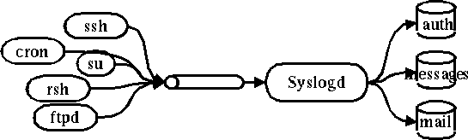
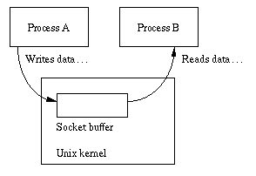
Syslog –
The system event logger (2)
/var/run/log
chbsd [/var/run] -chwong- ls -l /var/run/log
srw-rw-rw- 1 root wheel 0 Nov 4 11:45 /var/run/log

Slide 13
Configuring syslogd (1)
Basic format
  selector <Tab> action
    Selector: program.level
      Program: the program that sends the log message
      Level: the message severity level
    Action: tells what to do with the message
  Ex:
    mail.info /var/log/maillog

Slide 14
Configuring syslogd (2)
selector
  Syntax: facility.level
    Facility and level are predefined
    (see next page)
  Combined selector
    facility.level
    facility1,facility2.level
    facility1.level;facility2.level
    *.level
  Level indicate the minimum importance that a message must be logged
  A message matching any selector will be subject to the line’s action

Slide 15
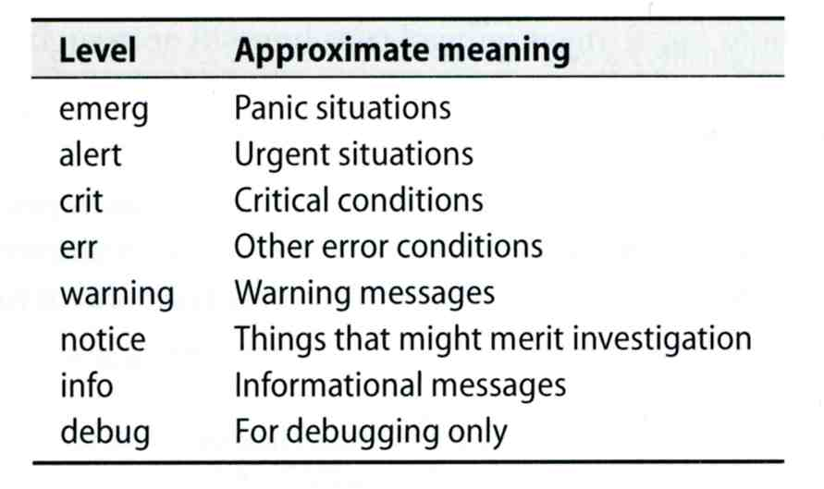
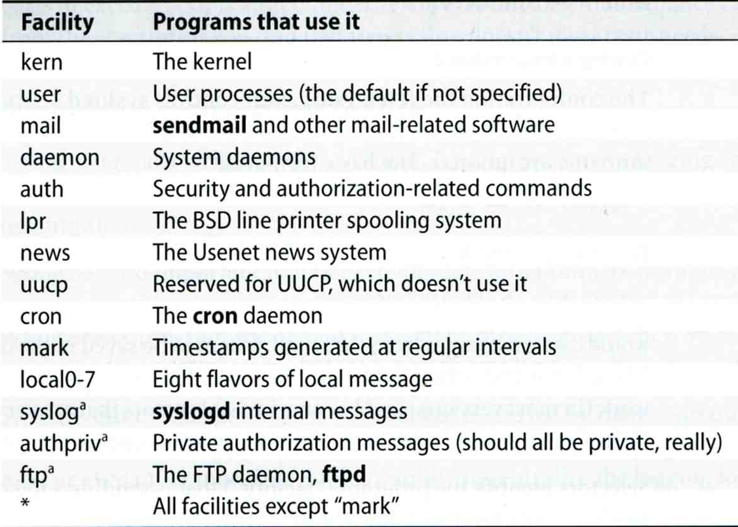
Configuring syslogd (3)

Slide 16
Configuring syslogd (4)
Action
  filename
    Write the message to a local file
  @hostname
    Forward the message to the syslogd on hostname
  @ipaddress
    Forwards the message to the host at that IP address
  user1, user2
    Write the message to the user’s screen if they are logged in
  *
    Write the message to all user logged in

Slide 17
Configuring syslogd (5)
Ex:
*.emerg /dev/console
*.err;kern,mark.debug;auth.notice;user.none /var/adm/console.log
*.info;kern,user,mark,auth.none @loghost
*alert;kern.crit;local0,local1,local2.info root
lpr.err ➔ /var/adm/console.log
@loghost

Slide 18
Configuring syslogd (6)
Output of syslogd
Aug 28 20:00:00 chbsd newsyslog[37324]: logfile turned over due to size>100K
Aug 28 20:01:45 chbsd sshd[37338]: error: PAM: authentication error for root from 204.16.125.3
Aug 28 20:01:47 chbsd sshd[37338]: error: PAM: authentication error for root from 204.16.125.3
Aug 28 20:07:15 chbsd sshd[37376]: error: PAM: authentication error for root from 204.16.125.3
Aug 28 20:07:17 chbsd sshd[37376]: error: PAM: authentication error for root from 204.16.125.3
Aug 30 09:47:49 chbsd sudo: chwong : TTY=ttyp4 ; PWD=/usr/home/chwong ; USER=root ; COMMAND=
Aug 30 22:02:02 chbsd kernel: arp: 140.113.215.86 moved from 00:d0:b7:b2:5d:89 to 00:04:e2:10:
Aug 30 22:05:13 chbsd kernel: arp: 140.113.215.86 moved from 00:04:e2:10:11:9c to 00:d0:b7:b2:
Sep 1 14:50:11 chbsd kernel: arplookup 0.0.0.0 failed: host is not on local network
Sep 3 13:16:29 chbsd sudo: chwong : TTY=ttyp4 ; PWD=/usr/ports ; USER=root ; COMMAND=/usr/b
Sep 3 13:18:40 chbsd sudo: chwong : TTY=ttyp4 ; PWD=/usr/ports ; USER=root ; COMMAND=/usr/l
Sep 3 13:25:06 chbsd sudo: chwong : TTY=ttyp4 ; PWD=/usr/ports ; USER=root ; COMMAND=/usr/l
Sep 3 13:27:09 chbsd kernel: arp: 140.113.215.86 moved from 00:d0:b7:b2:5d:89 to 00:04:e2:10:
Sep 3 13:27:14 chbsd kernel: arp: 140.113.215.86 moved from 00:04:e2:10:11:9c to 00:d0:b7:b2:
Sep 3 15:27:05 chbsd sudo: chwong : TTY=ttyp4 ; PWD=/usr/ports ; USER=root ; COMMAND=/usr/l
Sep 3 15:27:10 chbsd sudo: chwong : TTY=ttyp4 ; PWD=/usr/ports ; USER=root ; COMMAND=/usr/l
Sep 3 15:27:25 chbsd sudo: chwong : TTY=ttyp4 ; PWD=/usr/ports ; USER=root ; COMMAND=/usr/l

Slide 19
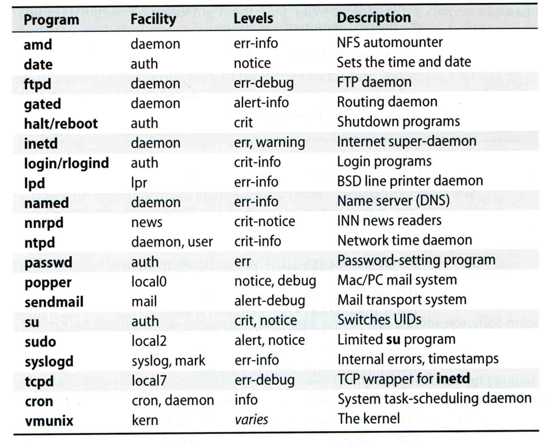
Software that use syslog

Slide 20
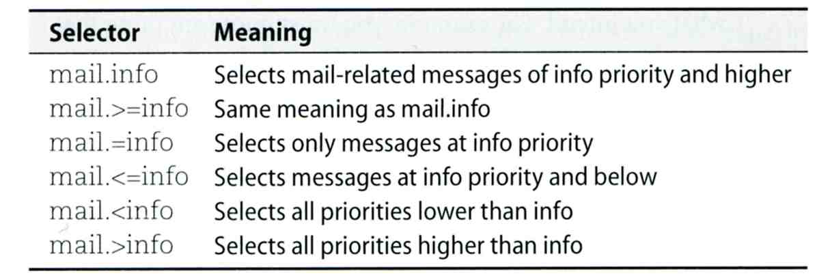
FreeBSD Enhancement (1)
Facility name
  FreeBSD allows you to select messages based on the name of the program
Severity level
!named
*.* /var/log/named.log

Slide 21
FreeBSD Enhancement (2)
Restriction log messages from remote hosts
  syslogd –a *.csie.nctu.edu.tw –a 140.113.209.0/24
  rc.conf
syslogd_enable="YES"
syslogd_flags="-a 140.113.209.0/24:* -a 140.113.17.0/24:*"

